Slide 1
Cube Run
(non working title)

Slide 2
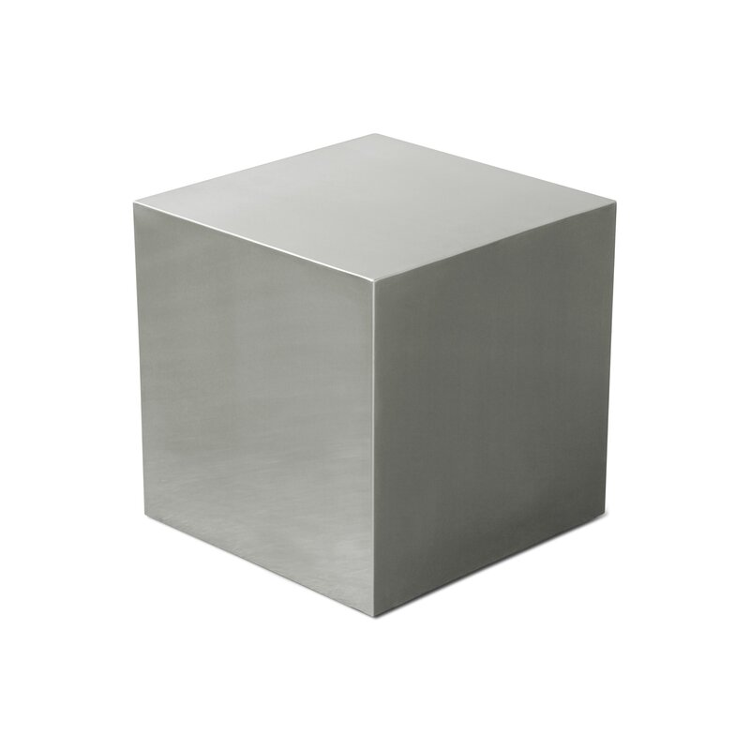

Assets
Cover Image GDD: Stainless steel cube end table (https://www.wayfair.com/furniture/pdx/gus-modern-stainless-steel-cube-end-table-gus1037.html)
Menu Image (Cube): Sugar Cube icon (https://4vector.com/free-vector/sugar-cube-icon-101801)
Sounds: - menu: Frankum minimal electronic grove techno - Ingame: Edtijo night soft techno
-Jump: evan schad 8-bit jump (https://freesound.org/)
Spikes are stolen from a friend!! Puppeteer spikes (Oscar Leiner Olsson)

Slide 3
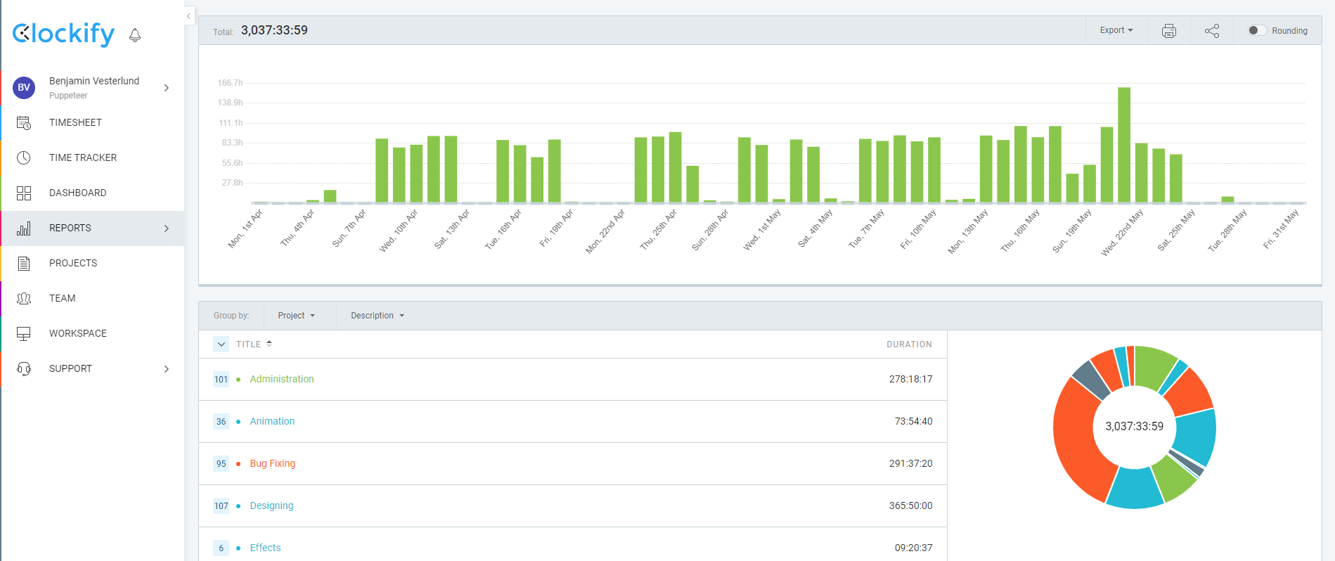
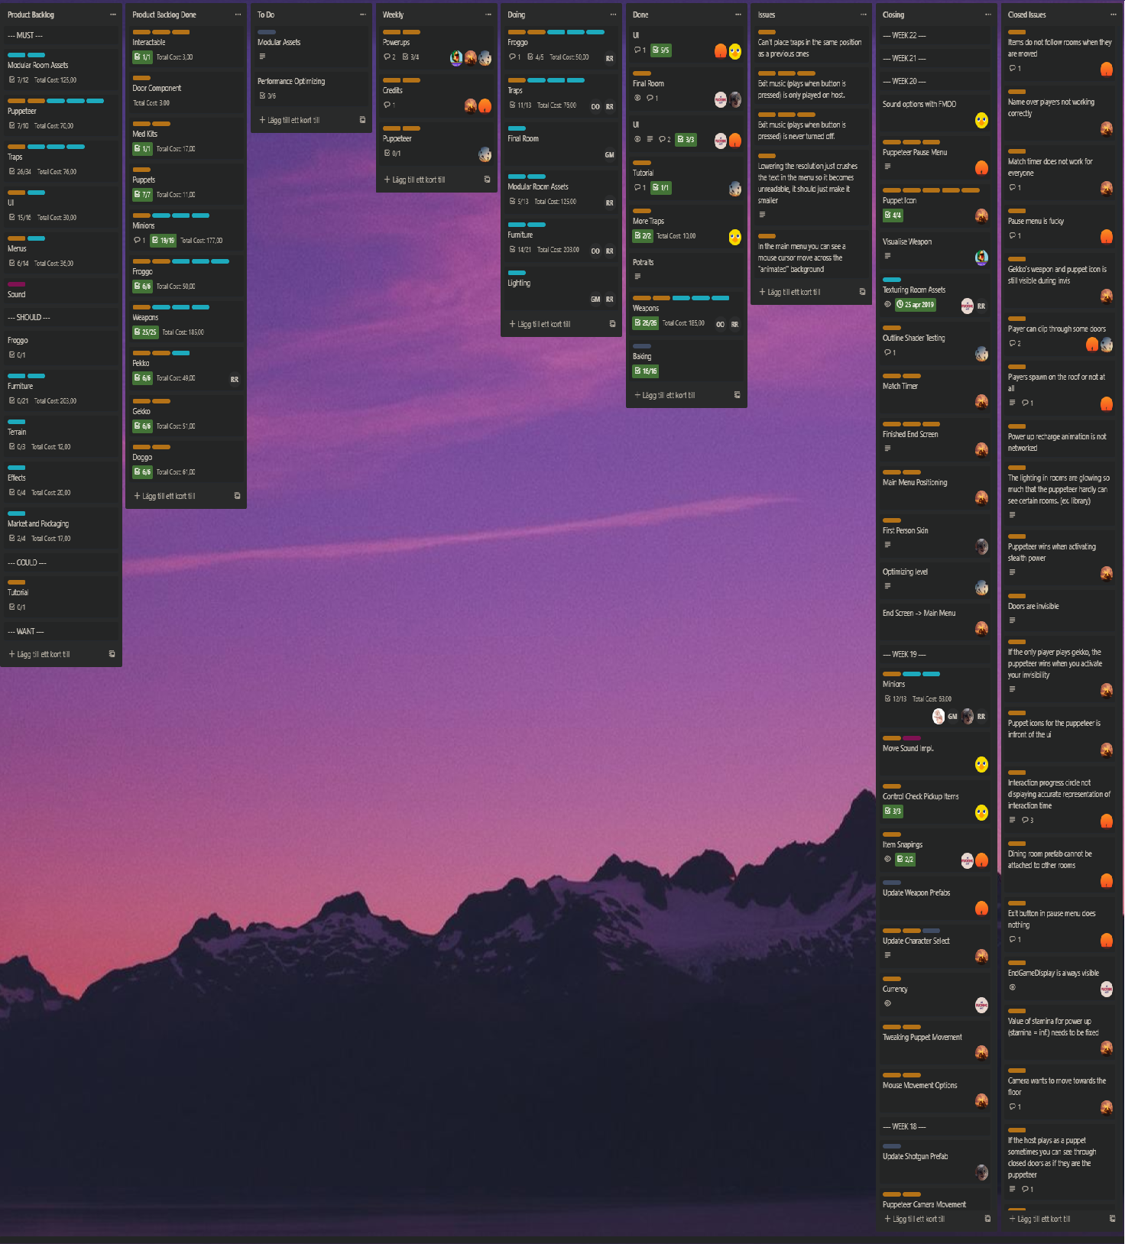
Production Tools
Planing: Trello (https://trello.com/)
Time keeping: Clockify (https://clockify.me/)
Trello is super nice and simple to use, colorcode and arrange tasks. Super handy to split tasks into smaller tasks. (good scrumboard)
Clockify is a nice Timmer extention in crome that makes it super easy to track time worked on a project or task.

Slide 4
Code stuff
Back and exit button
Map moving & generation
Audio Mixer
Smooth camera movement

